Slide 1


Barbara Cooper
July 19, 2024

Slide 2

Outline
Executive Summary
Introduction
Methodology
Results
Conclusion
Appendix

Slide 3
Executive Summary
Summary of methodologies
Data Collection API and Web scraping
Data Wrangling
Exploratory Data Analysis with SQL and Data Visualization
Visual Analytics with Folium and Plotly Dash
Machine Learning Prediction
Summary of all results
Exploratory Data Analysis
Predictive Analytics

Slide 4
Introduction
Background
SpaceX advertises Falcon 9 rocket launches on its website with a cost of 62 million dollars; other providers cost upward of 165 million dollars each, much of the savings is because SpaceX can reuse the first stage. Therefore, if we can determine if the first stage will land, we can determine the cost of a launch. This information can be used if an alternate company wants to bid against SpaceX for a rocket launch. The goal of this project is to create a machine learning pipeline to predict if the first stage will land.
Problems
What factors contribute to a successful landing?
What is the success rate of landings
Is location a factor in successful launches?

Slide 5

Section 1

Slide 6
Methodology
Executive Summary
Data collection methodology:
Data was collected using a request to the SpaceX API and from a web scraping using historical launch records from Wikipedia.
Perform data wrangling
Identify and calculate the percentage of missing values in each attribute and identify attribute data types.
Create the target variable ‘landing outcome’ based on value counts from the Outcome attribute.
Perform exploratory data analysis (EDA) using visualization and SQL
Perform interactive visual analytics using Folium and Plotly Dash
Perform predictive analysis using classification models

Slide 7
Data Collection
The dataset was obtained using a request to the SpaceX API.
Request & Parse launch data using GET request
JSON Results - Normalize
Pandas Data frame

Slide 8
Data Collection – SpaceX API
SpaceX API Request
Booster Version
Launch Site
Payload Data
Core Data
https://github.com/bcoopersql/IBM_Coursera/blob/main/Step%201a%20jupyter-labs-spacex-data-collection-api.ipynb

Slide 9
Data Collection - Scraping
Request from Wiki page for Falcon 9
Response into BeautifulSoup object
HTML extract of features from HTML table
Extract features into Pandas dataframe
https://github.com/bcoopersql/IBM_Coursera/blob/main/Final%20Assignment%20Webscraping.ipynb

Slide 10
Data Wrangling
Identify missing values
Identify numerical and categorical features
Calculate # of launches per site
https://github.com/bcoopersql/IBM_Coursera/blob/main/Step%201%20labs-jupyter-spacex-Data%20wrangling.ipynb
Create outcome label (0= failed landing, 1 = successful landing)
Calculate mission outcome per orbit type
Calculate # and occurrence per orbit type

Slide 11
EDA with Data Visualization
The visualizations below were created to evaluate SpaceX dataset features and how they relate to launch outcomes.
Flight number and payload features to see how they affect launch outcomes.
Payload and launch site.
Success rate and orbit type.
Flight number and orbit type.
Payload and orbit type
Success rate per year
https://github.com/bcoopersql/IBM_Coursera/blob/main/Step%202a%20jupyter-labs-eda-dataviz.ipynb

Slide 12
EDA with SQL
Display the names of the unique launch sites in the space mission.
Display 5 records where launch sites begin with the string 'CCA’
Display the total payload mass carried by boosters launched by NASA (CRS)
Display average payload mass carried by booster version F9 v1.1
List the date when the first successful landing outcome in ground pad was achieved.
List the names of the boosters which have success in drone ship and have payload mass greater than 4000 but less than 6000.
List the total number of successful and failure mission outcomes.
List the names of the booster_versions which have carried the maximum payload mass.
List the records which will display the month names, failure landing_outcomes in drone ship ,booster versions, launch_site for the months in year 2015.
Rank the count of landing outcomes (such as Failure (drone ship) or Success (ground pad)) between the date 2010-06-04 and 2017-03-20, in descending order.
https://github.com/bcoopersql/IBM_Coursera/blob/main/Step%202b%20jupyter-labs-eda-sql-coursera_sqllite.ipynb

Slide 13
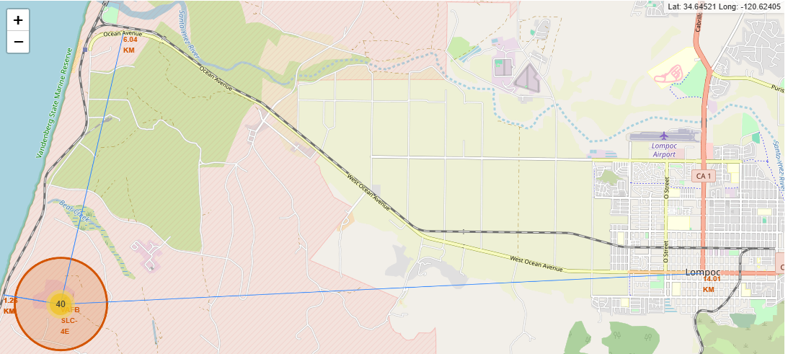
Build an Interactive Map with Folium
Launch Sites Locations Analysis with Folium
Folium.Circle was used to highlight an area with a text label on a specific coordinate such as initial center point of NASA Johnson Space Center in Houston, Tx.
MarkerCluster objects were used to create markers for all launch records.
MousePoisition to get coordinate for mouse over a point on map
PolyLine to draw a line between launch site to the nearest city, railway and highway.
https://github.com/bcoopersql/IBM_Coursera/blob/main/Step%203%20lab_jupyter_launch_site_location.ipynb

Slide 14
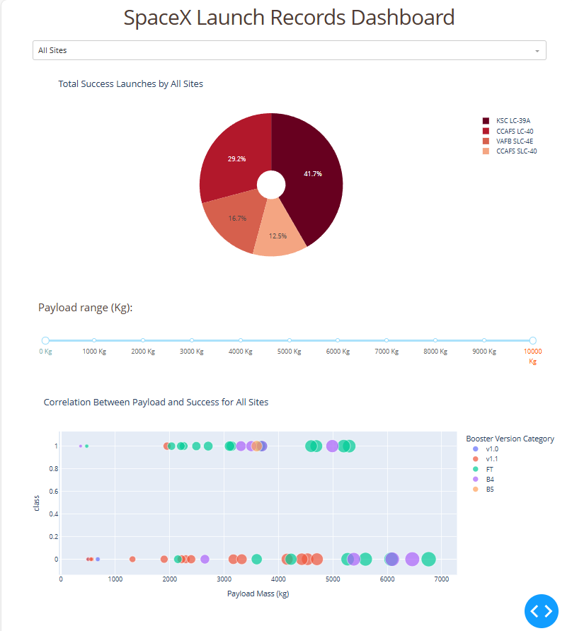
Build a Dashboard with Plotly Dash
A donut chart showing total successful launches by all sites was added with a drop-down selection box to filter by launch site so success rate could be compared visually.
Payload is a key feature in launch success or failure. The scatter plot shows the correlation between payload mass and booster version. The payload range slider can be adjusted manually to filter the scatter plot to show which booster versions were successful or not for the site selected or for all sites.
https://github.com/bcoopersql/IBM_Coursera/blob/main/SpaceXPlotlyDashboard.py

Slide 15
Predictive Analysis (Classification)
Data was loaded into Pandas and Numpy, transformed then split into training and testing datasets.
4 machine learnings models were built.
Decision Tree
Support Vector Machine
K-nearest neighbors
Logistic Regression
Hyperparameters were tuned using GridSearchCV.
Accuracy was the metric used to evaluate the models.
https://github.com/bcoopersql/IBM_Coursera/blob/main/Step%205%20SpaceX_Machine_Learning_Prediction_Part_5.jupyterlite.ipynb

Slide 16
Results
Exploratory data analysis results
Interactive analytics demo in screenshots
Predictive analysis results

Slide 17

Section 2

Slide 18
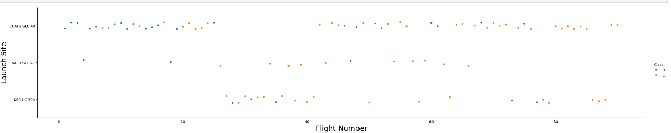
Flight Number vs. Launch Site
Larger flight numbers have a higher launch success rate than lower flight numbers.

Slide 19
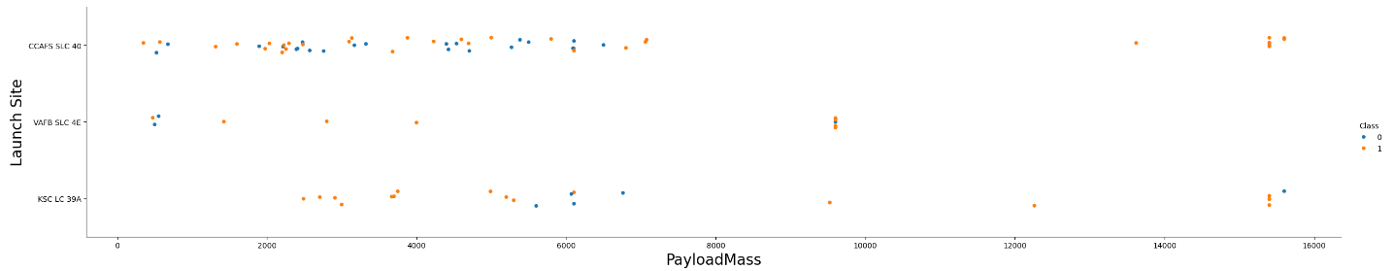
Payload vs. Launch Site
Payloads with lower mass have more launches than heavier payloads.

Slide 20
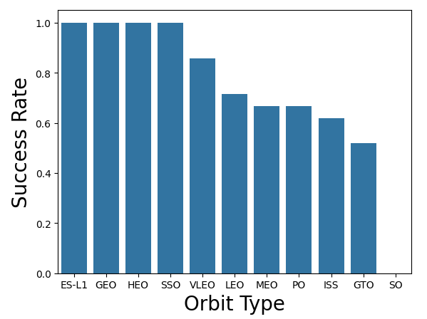
Success Rate vs. Orbit Type
ES-L1, GEO, HEO, and SSO have the highest success rate of the 11 orbit types

Slide 21
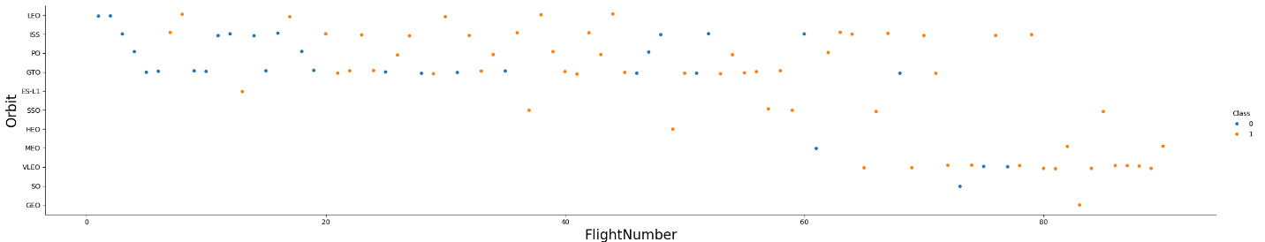
Flight Number vs. Orbit Type
LEO Orbit success is related to the # of flights.
No relationship was found between the # of flights and GTO orbit.

Slide 22
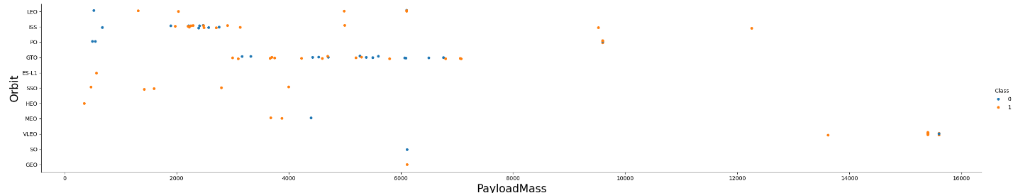
Payload vs. Orbit Type
Polar, LEO and ISS had more successful landings with heavier payloads than other orbit types.

Slide 23
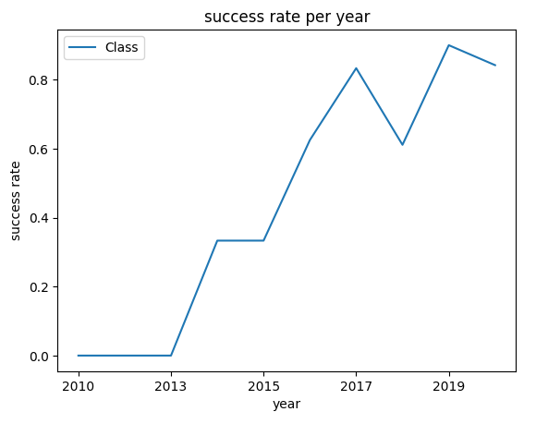
Launch Success Yearly Trend
Success rate has continued to increase since 2013.

Slide 24
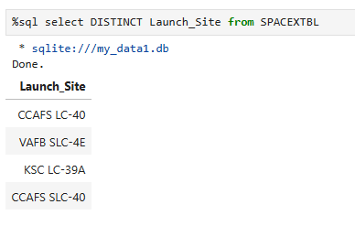
All Launch Site Names
The names of the unique launch sites were obtained from the SpaceX dataset which was loaded into a database table

Slide 25
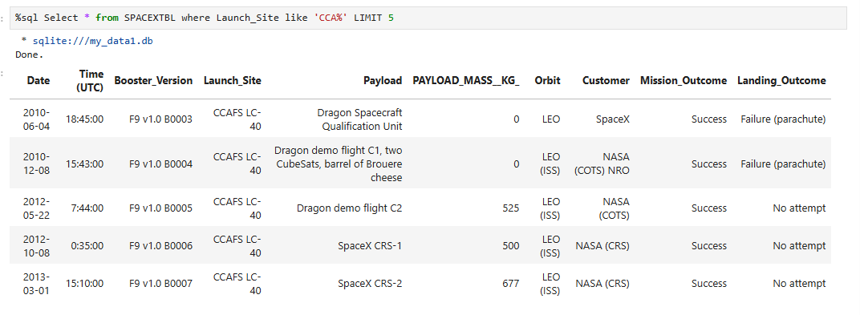
Launch Site Names Begin with 'CCA'
5 records from the SpaceX dataset that begin with the letters ‘CCA’.

Slide 26
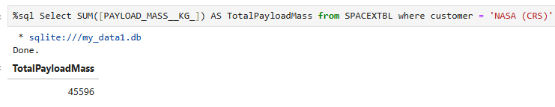
Total Payload Mass
Total payload carried by boosters from NASA

Slide 27
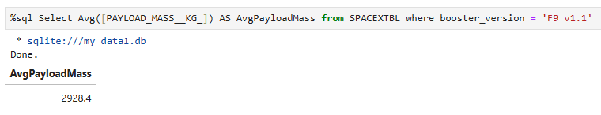
Average Payload Mass by F9 v1.1
Average payload mass carried by booster version F9 v1.1

Slide 28
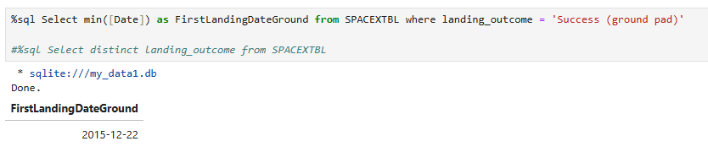
First Successful Ground Landing Date
Date of the first successful landing outcome on ground pad

Slide 29
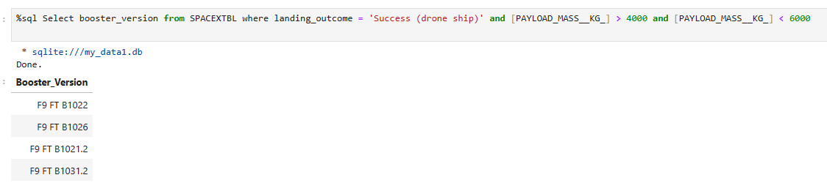
Successful Drone Ship Landing with Payload between 4000 and 6000
Names of the boosters that successfully landed on drone ship and had payload mass greater than 4000 but less than 6000

Slide 30
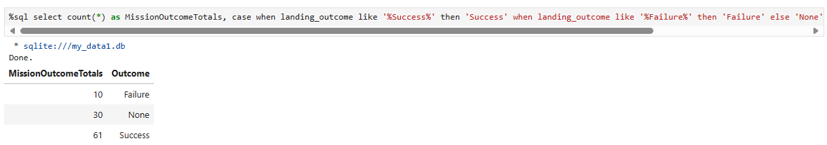
Total Number of Successful and Failure Mission Outcomes

Slide 31
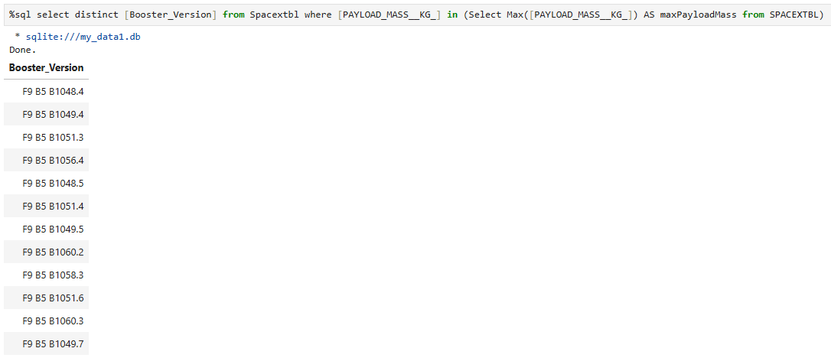
Boosters Carried Maximum Payload
Names of the booster versions which have carried the maximum payload mass

Slide 32
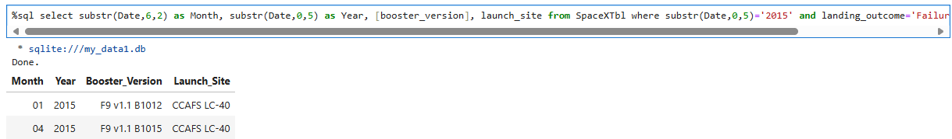
2015 Launch Records
Failed landing_outcomes in drone ship, their booster versions, and launch site names for in year 2015

Slide 33
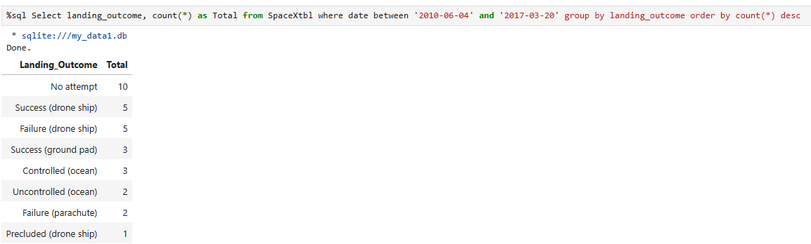
Rank Landing Outcomes Between 2010-06-04 and 2017-03-20
Rank of landing outcomes (such as Failure (drone ship) or Success (ground pad)) between the date 2010-06-04 and 2017-03-20, in descending order

Slide 34

Section 3

Slide 35
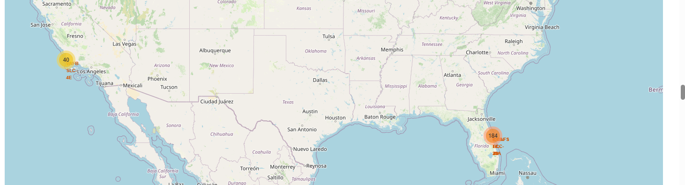
Space X Launch Sites
Space X Launches from 4 launch sites, VAFB-SLC4E in California, and 3 in Florida KSC LC-39A, CCAFS LC40, and CCAFS SLC 40

Slide 36
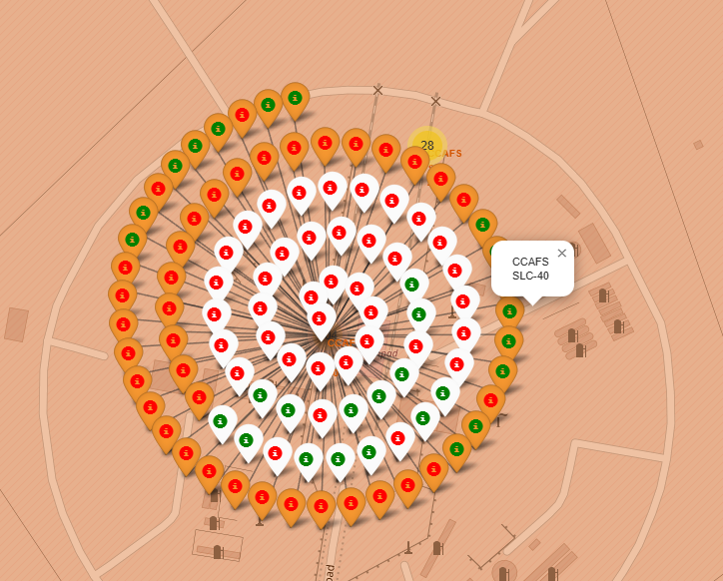
Launch Outcomes in Florida
Green markers on the map indicate a successful launch, red shows the failed launches.

Slide 37
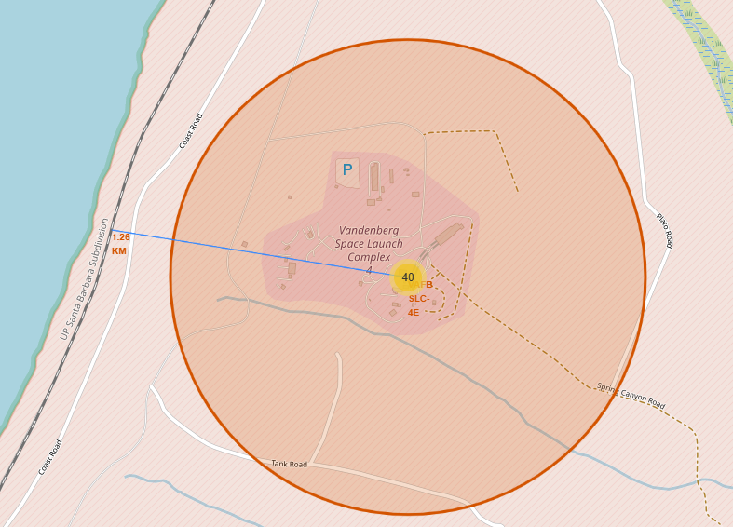
Coastal Launch Site in California
Vandenberg Space Launch Complex 4 is 1.26 KM from the coastline of California.

Slide 38

Section 4

Slide 39
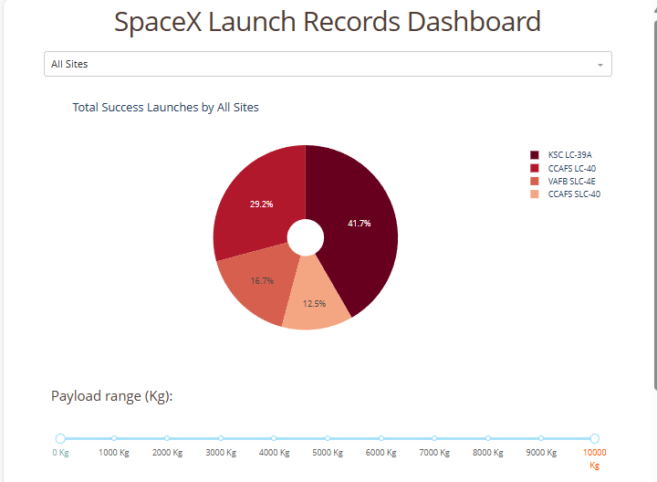
Launch Site Success
Kennedy Space Center KSC LC-39A has the overall highest success rate of 41.7% followed by Cape Canaveral Space Launch Complex 40 with 29.2%

Slide 40
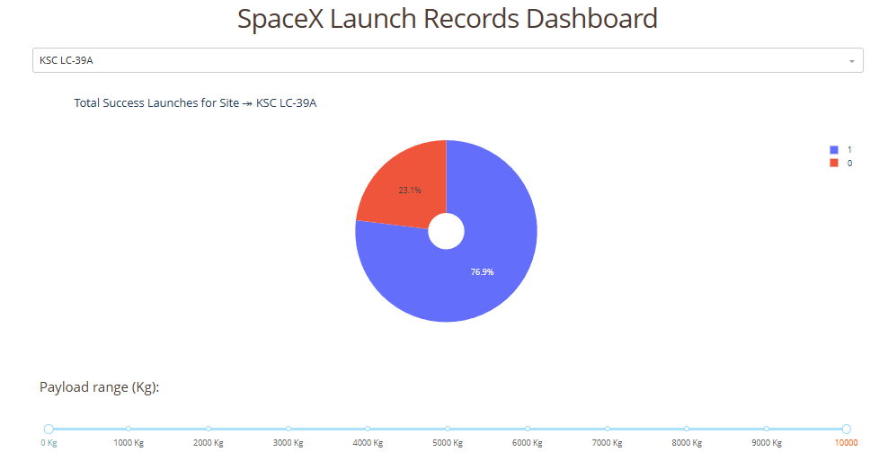
Kennedy Space Center Launch Complex 39A has the Most Successful Launches
76.9% of KSC LC39A are a success; the highest success rate of the 4 launch sites.

Slide 41
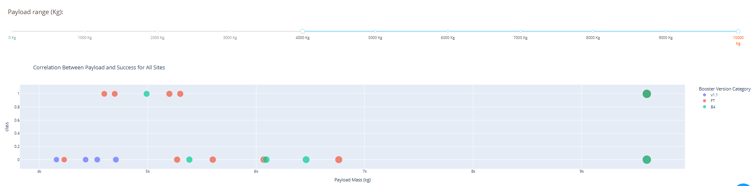
Launch Success by Payload
KSC LC39A had a success rate of 76.9% with a payload range of 4,000kg or higher.
A correlation was shown between payload and success rate for all booster version with successful launches containing payloads in the range of 2K to about 6K.

Slide 42

Section 5

Slide 43
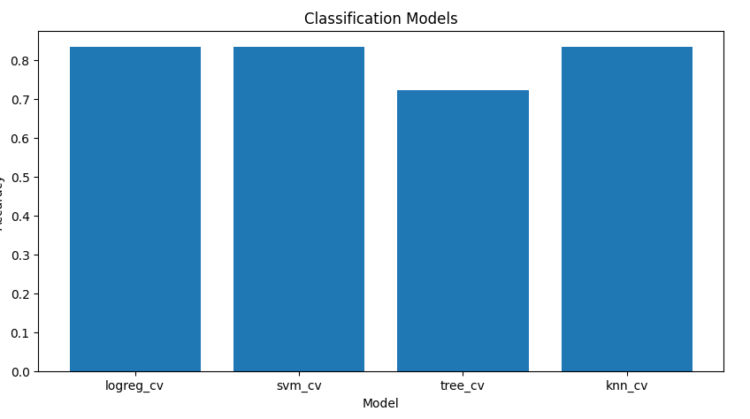
3 Classification Models Tie for Most Accurate
Logistic Regression, Support Vector Machine and K-Nearest Neighbors all achieve 83.3% accuracy.

Slide 44
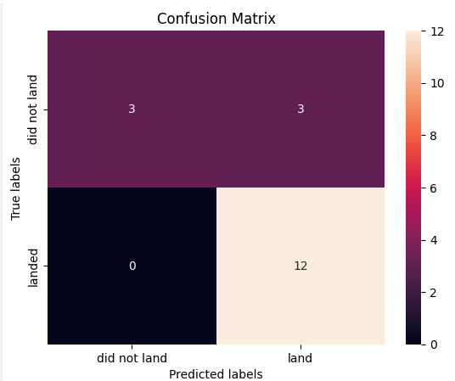
Confusion Matrix
Logistic Regression, K Nearest Neighbors and Support Vector Machine are the best performing models and all three achieve 83.33% accuracy with15 in the test set being classified correctly and 3 incorrectly indicating they did not land when in fact they landed successfully..

Slide 45
Conclusions
Logistic regression, Support Vector Machine and KNN are highly accurate models for predicting the outcome of SpaceX launches.
Payload mass less than 6K have high success rates than heavier payloads.
Kennedy Space Center Launch complex 39A has the highest successful launch site rating of the 4 launch sites evaluated.
Orbit Type ES-L1,GEO, HEO, and SSO have the highest success rate of the 11 orbit types.
The trend of successful launches indicates it will continue to rise.

Slide 46


